Slide 1
Magical SQL
Hogwarts Traders

Slide 2

Intro video
https://www.youtube.com/watch?v=j3GFUZm0ghM

Slide 3



Slide 4
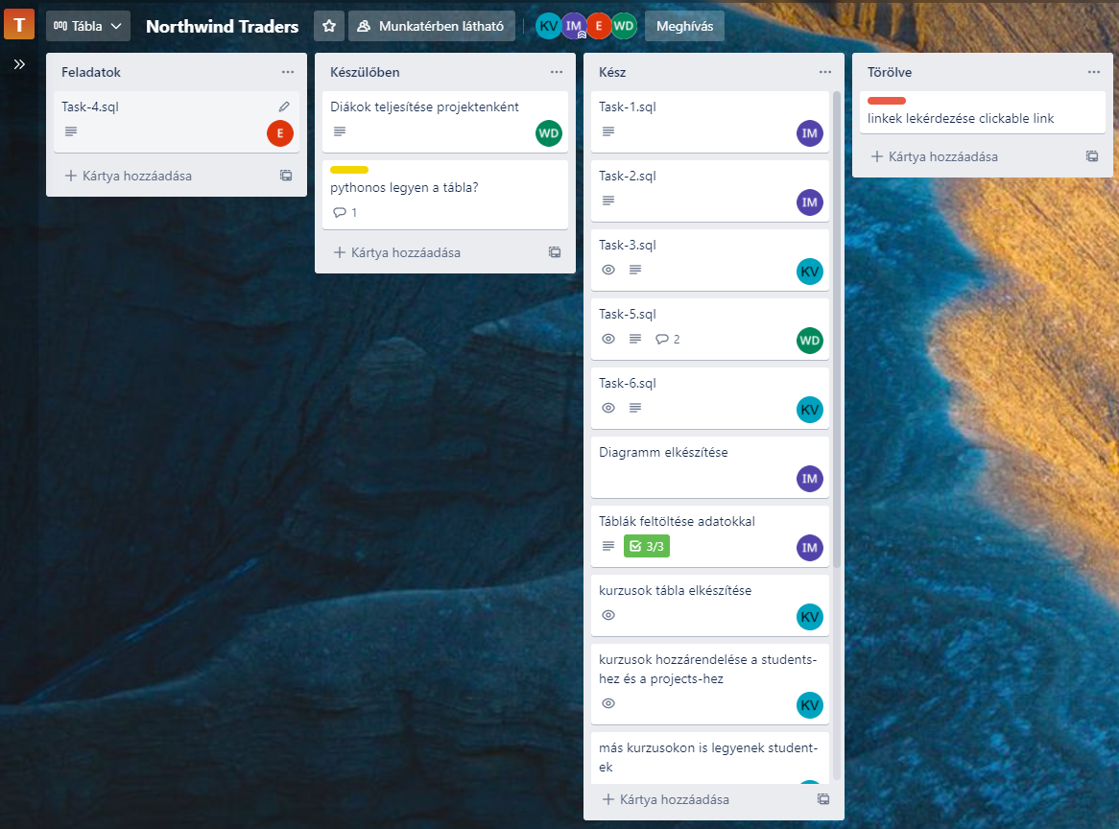
TRELLO
https://trello.com/b/c1x4c9fi/northwind-traders

Slide 5
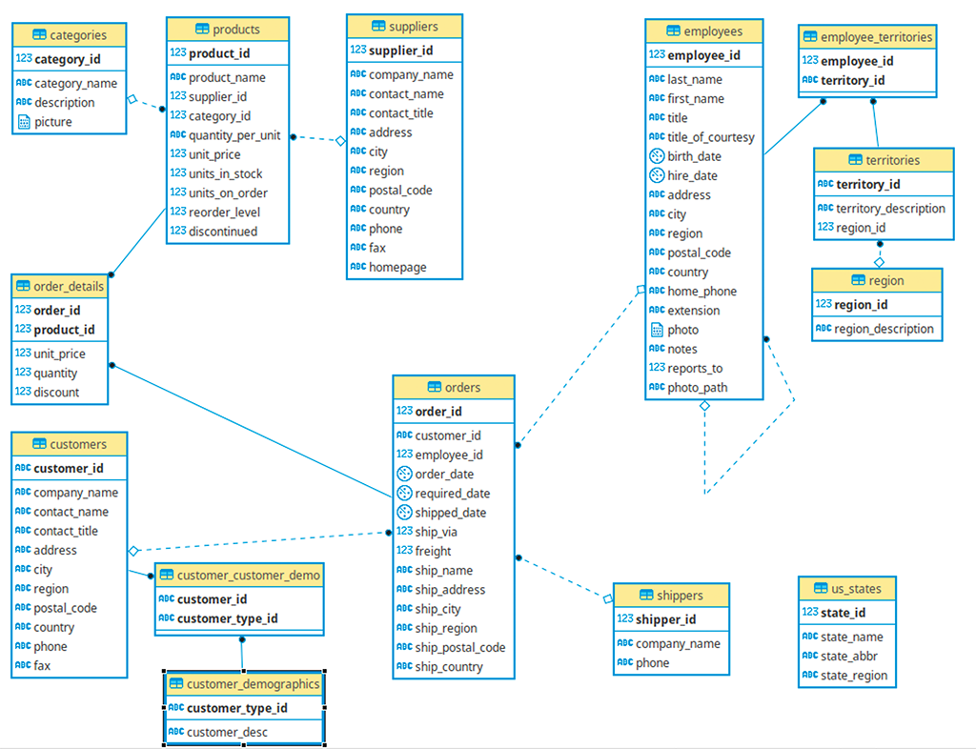

Slide 6


Slide 7
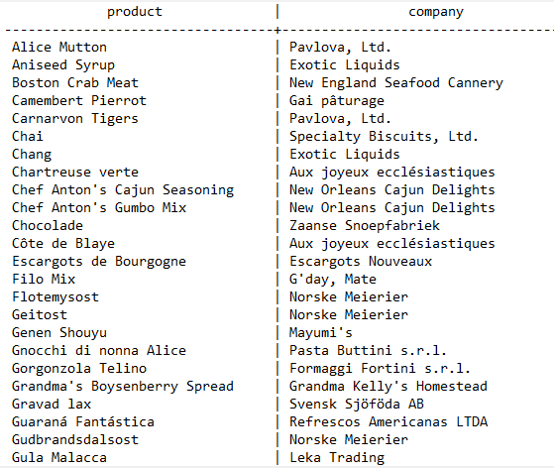
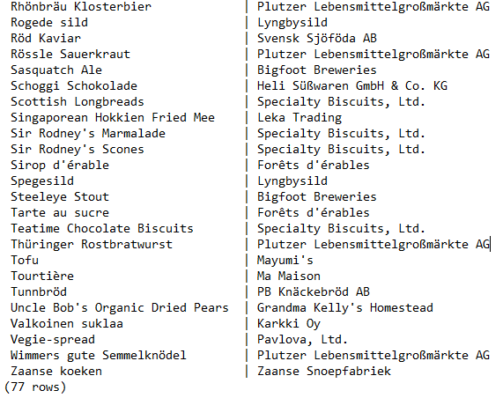
List products and their suppliers
SELECT products.product_name
AS product, suppliers.company_name
AS company
FROM products
INNER JOIN suppliers
ON products.supplier_id = suppliers.supplier_id
ORDER BY products.product_name, suppliers.company_name ASC;
...

Slide 8
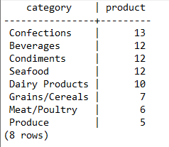
Count products by categories
SELECT categories.category_name
AS category,
COUNT(products.product_id)
AS number_of_products
FROM categories
INNER JOIN products
ON categories.category_id = products.category_id
GROUP BY categories.category_name
ORDER BY number_of_products DESC,
categories.category_name ASC;

Slide 9
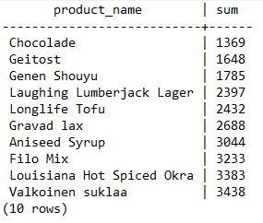
Top 10 Worst selling products
SELECT products.product_name
AS product_name,
ROUND(SUM(order_details.quantity*order_details.unit_price*(1-order_details.discount)))
AS sum
FROM products
JOIN order_details
ON products.product_id = order_details.product_id
GROUP BY product_name
ORDER BY sum
LIMIT 10;

Slide 10
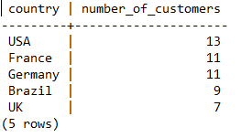
Important countries
SELECT customers.country
AS country,
COUNT(DISTINCT customers.customer_id)
AS number_of_customers
FROM customers
GROUP BY customers.country
HAVING COUNT(DISTINCT customers.customer_id)>5
ORDER BY number_of_customers DESC;

Slide 11
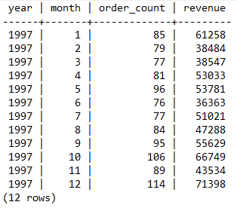
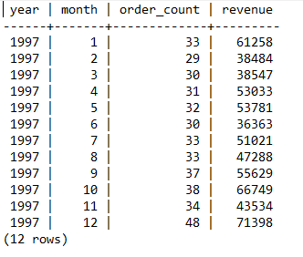
Total revenue by month
SELECT EXTRACT(year FROM orders.order_date)
AS year,
EXTRACT(month FROM orders.order_date)
AS month,
COUNT(DISTINCT order_details.order_id)
AS order_count,
ROUND(SUM(order_details.unit_price*order_details.quantity*(1-order_details.discount)))
AS revenue
FROM orders
JOIN order_details
ON orders.order_id = order_details.order_id
WHERE EXTRACT(year FROM orders.order_date) = 1997
GROUP BY year, month;

Slide 12
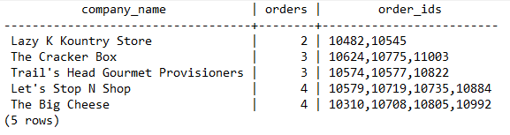
Get order numbers for each customer from the US with less than 5 orders
SELECT customers.company_name
AS company_name,
COUNT(orders.order_id)
AS orders,
STRING_AGG(orders.order_id::TEXT, ',')
AS order_ids
FROM customers
JOIN orders
ON customers.customer_id = orders.customer_id
WHERE customers.country = 'USA'
GROUP by customers.company_name
HAVING COUNT(orders.customer_id)<5
ORDER BY orders, company_name;

Slide 13


Slide 14
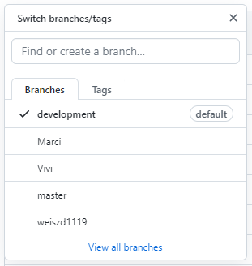
GIT branching
Git clone [repoistory]
Git checkout –b [branch name]
Git add .
Git push origin [branch name]
https://github.com/CodecoolGlobal/northwind-traders-python-viewxy

Slide 15

2 part – Codecool curriculum

Slide 16
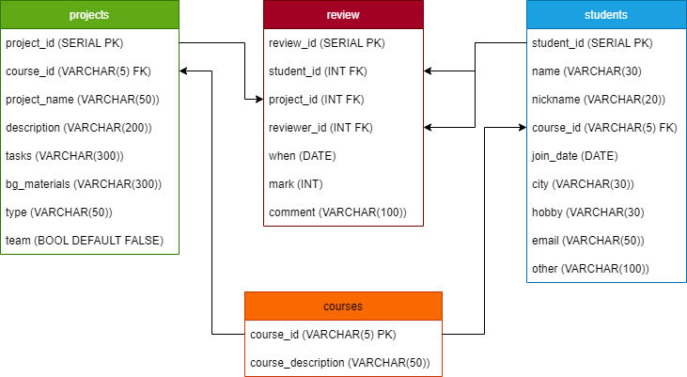

Slide 17


Slide 18
Create Database
Created the database using SQL file, that can be imported
Can be created with \i command and specifying the file route and name
Used these methods:
DROP TABLE IF EXISTS ... CASCADE
CREATE TABLE
INSERT INTO
ALTER TABLE ... ADD CONSTRAINT ... FOREIGN KEY
Worked with data types:
VARCHAR
INT
SERIAL
BOOL
DATE

Slide 19


Slide 20
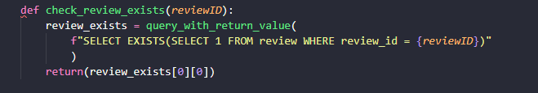
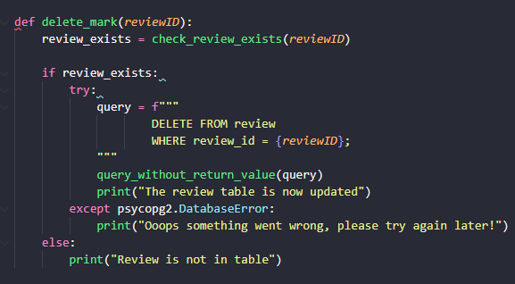
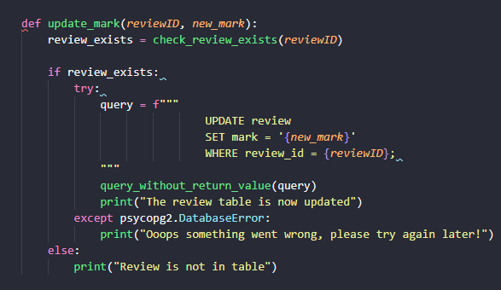
DELETE és UPDATE

Slide 21

A tananyag kilistázása kurzusonként
SELECT *
FROM projects
WHERE projects.course_id = 'TST01'
GROUP BY course_id, projects.project_id
ORDER BY projects.project_id;
SELECT *
FROM projects
WHERE projects.course_id = 'TST02'
GROUP BY course_id, projects.project_id
ORDER BY projects.project_id;
SELECT *
FROM projects
WHERE projects.course_id = 'FRT01'
GROUP BY course_id, projects.project_id
ORDER BY projects.project_id;
SELECT *
FROM projects
WHERE projects.course_id = 'BCK01'
GROUP BY course_id, projects.project_id
ORDER BY projects.project_id;
SELECT *
FROM projects
WHERE projects.course_id = 'SYS01'
GROUP BY course_id, projects.project_id
ORDER BY projects.project_id;

Slide 22


Slide 23
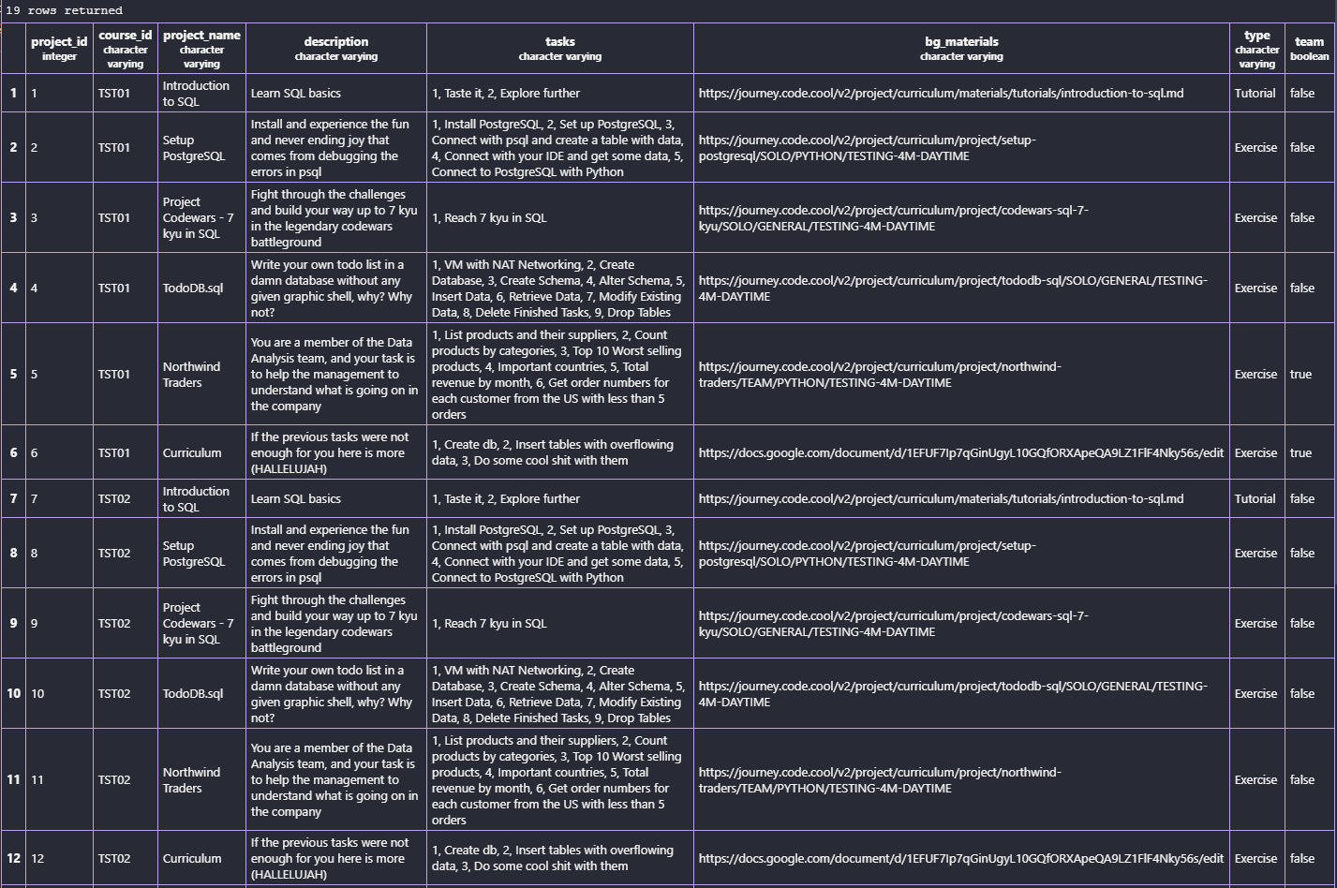
Az egyes projektek megjelenítése azok minden elemével együtt
SELECT * FROM projects
ORDER BY project_id;

Slide 24
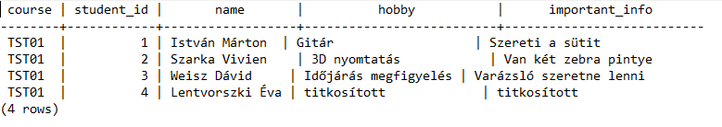
A diákok alapadatainak listája kurzusonként
SELECT students.course_id AS course,
students.student_id AS student_id,
students.name AS name,
students.hobby AS hobby,
students.other AS important_info
FROM students
WHERE students.course_id = 'TST01'
ORDER BY students.student_id;

Slide 25
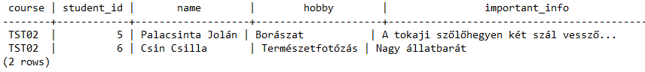
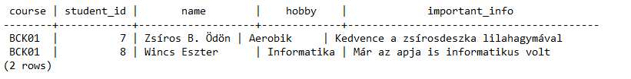
A diákok alapadatainak listája kurzusonként
SELECT students.course_id AS course,
students.student_id AS student_id,
students.name AS name,
students.hobby AS hobby,
students.other AS important_info
FROM students
WHERE students.course_id = 'TST02'
ORDER BY students.student_id;
SELECT students.course_id AS course,
students.student_id AS student_id,
students.name AS name,
students.hobby AS hobby,
students.other AS important_info
FROM students
WHERE students.course_id = 'BCK01'
ORDER BY students.student_id;

Slide 26
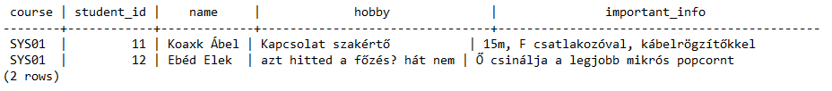
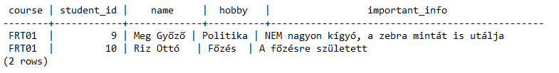
A diákok alapadatainak listája kurzusonként
SELECT students.course_id AS course,
students.student_id AS student_id,
students.name AS name,
students.hobby AS hobby,
students.other AS important_info
FROM students
WHERE students.course_id = 'SYS01'
ORDER BY students.student_id;
SELECT students.course_id AS course,
students.student_id AS student_id,
students.name AS name,
students.hobby AS hobby,
students.other AS important_info
FROM students
WHERE students.course_id = 'FRT01'
ORDER BY students.student_id;

Slide 27
A diákok projektenkénti teljesítései
SELECT a.name as student,
projects.project_name,
b.name as reviewer,
review.mark AS mark,
review.comment
FROM review
JOIN students a
ON review.student_id =a.student_id
JOIN students b
ON review.reviewer_id = b.student_id
JOIN projects
ON projects.project_id = review.project_id
ORDER BY a.name;

Slide 28
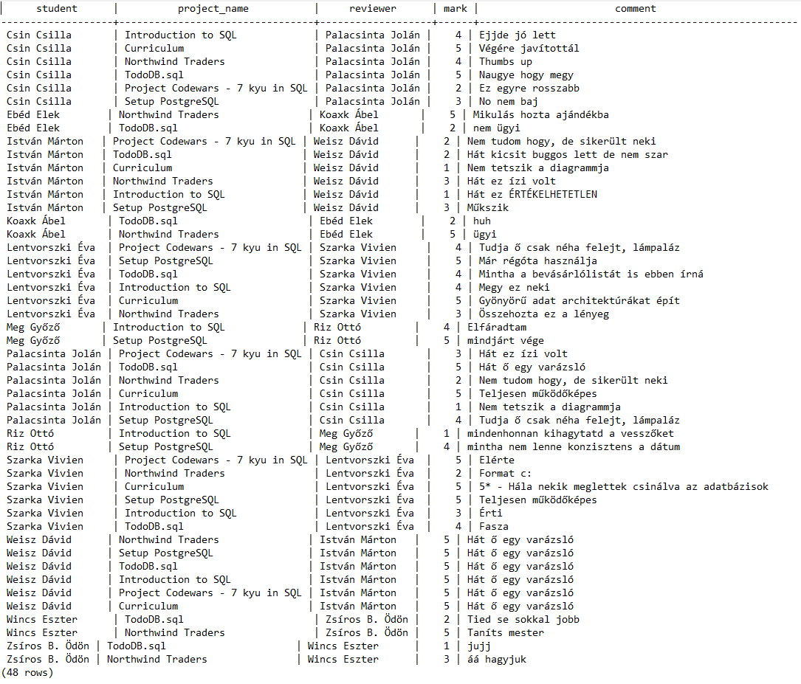

Slide 29
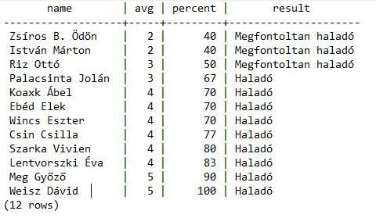
Összesített eredmény a diákok teljesítéseiről
SELECT students.name,
ROUND(AVG(review.mark)) AS AVG,
ROUND(AVG(review.mark)/5*100) AS PERCENT,
CASE
WHEN ROUND(AVG(review.mark)/5*100) >= 60
THEN 'Haladó'
ELSE 'Megfontoltan haladó'
END AS RESULT
FROM students
FULL JOIN review
ON students.student_id = review.student_id
GROUP BY students.name ORDER BY percent;

Slide 30
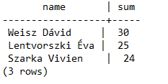
A 3 legjobban teljesítő diák
SELECT students.name,
SUM(review.mark)
FROM students
INNER JOIN review
ON review.student_id = students.student_id
GROUP BY students.name
ORDER BY SUM(review.mark) DESC
LIMIT 3;

Slide 31

Intro video

Slide 32
The team
Marci
Dávid
Évi
Spokesperson wizard
Video editor wizard
Vivi
Support witch
Database witch

Slide 33

Thank you for your attention!

